Slide 1
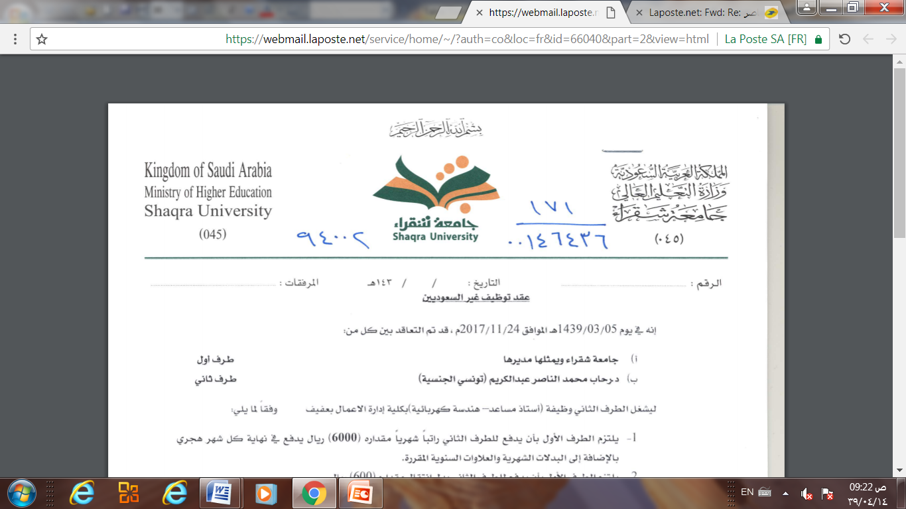
Database Management system
Dr. Amir Hammamix
Based on Dr. Rihab Mohamed Naceur ABDELKRIM Lecture
1442

Slide 2
Outline
1- Introduction
2- Characteristics of the Database Approach
3-Actors on the Scene and Workers behind Scene
4-Advantages of Using the DBMS Approach
5- A Brief History of Database Applications
6- When Not to Use a DBMS

Slide 3
Outline
1- Introduction
2- Characteristics of the Database Approach
3-Actors on the Scene and Workers behind Scene
4-Advantages of Using the DBMS Approach
5- A Brief History of Database Applications
6- When Not to Use a DBMS

Slide 4
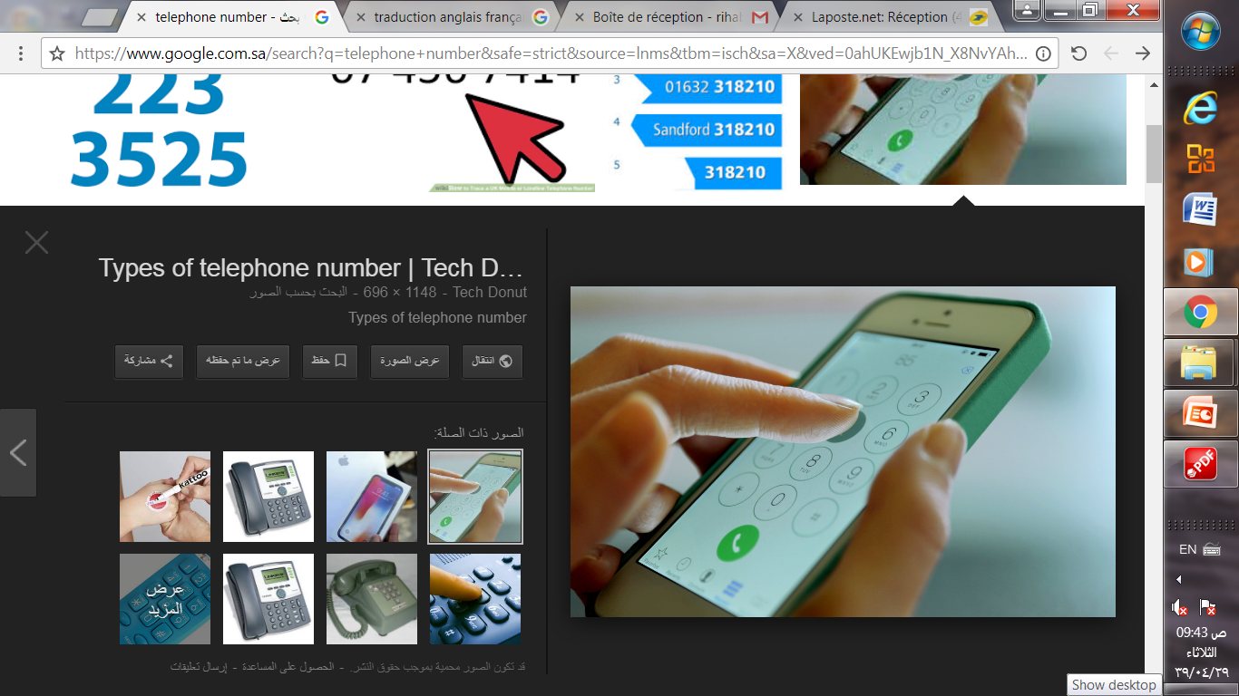
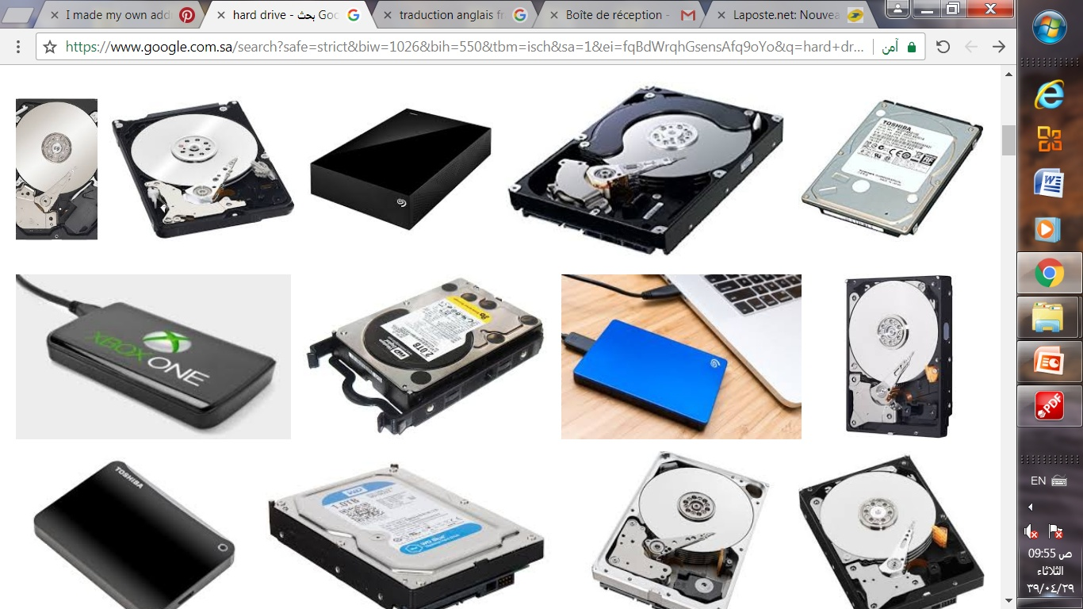

1- Introduction
Databases and database technology have a major impact on the growing use of computers.
A database is a collection of related data.
For example
consider
the names,
telephone numbers,
addresses of the people you know.
You may have recorded this data in an indexed address book or you may have stored it on a hard drive, using a personal computer and software such as Microsoft Access or Excel.
Address book
Hard drive

Slide 5
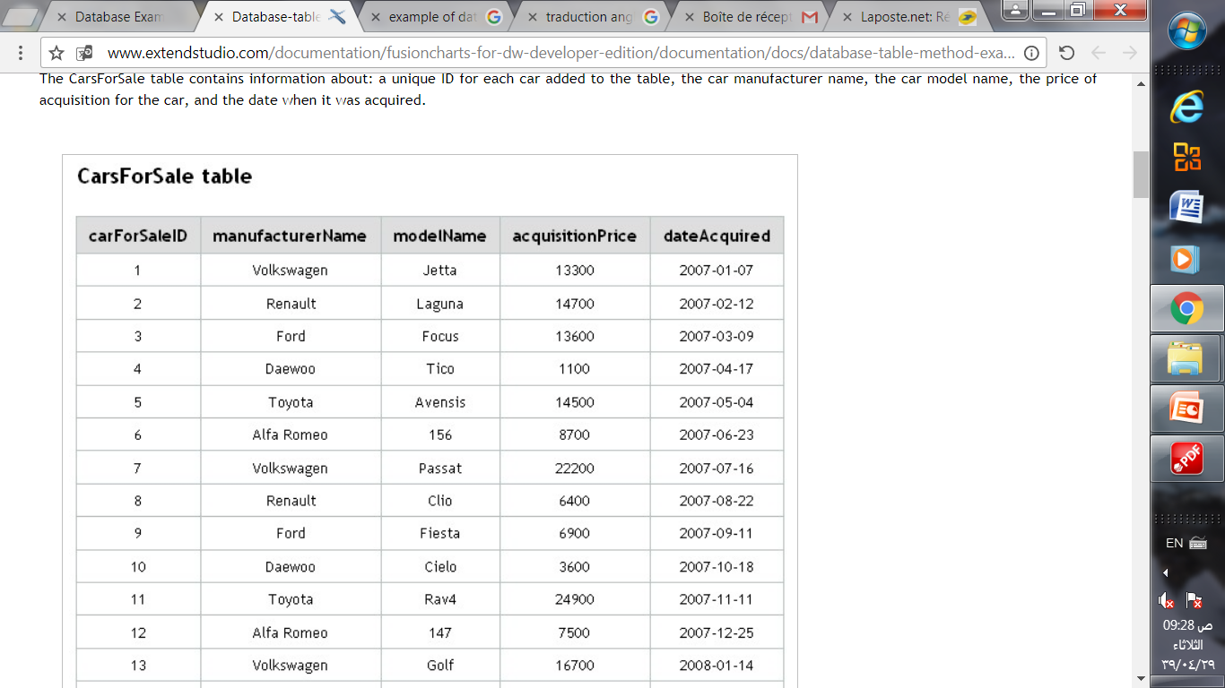
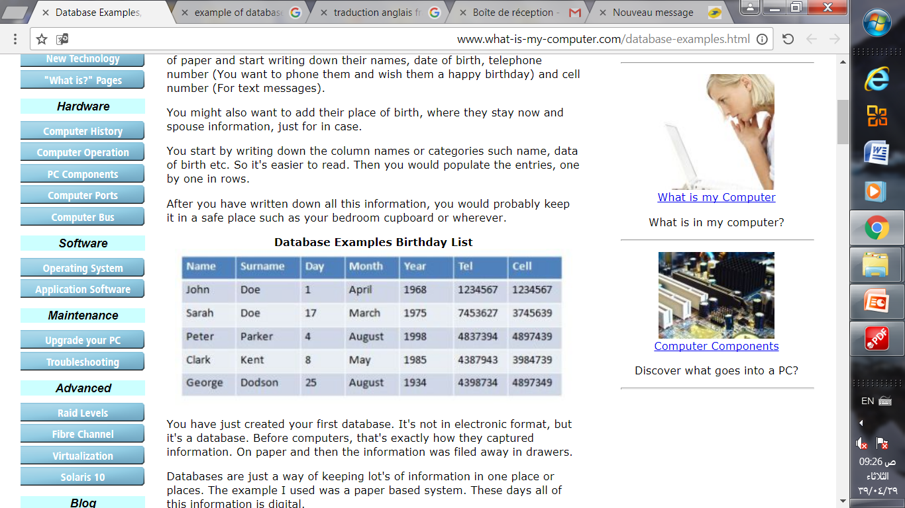
This collection of related data with an implicit meaning
is a Database
Examples of Database

Slide 6
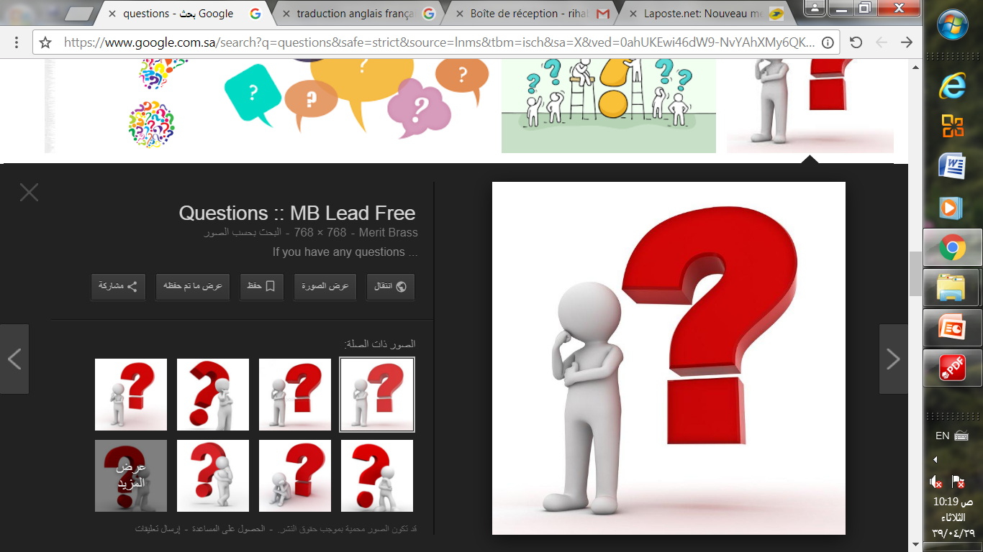
What is DataBase Management System DBMS ???
A database management system (DBMS)
is a collection of programs that enables users to create and maintain a database.

Slide 7
Outline
1- Introduction
2- Characteristics of the Database Approach
3-Actors on the Scene and Workers behind Scene
4-Advantages of Using the DBMS Approach
5- A Brief History of Database Applications
6- When Not to Use a DBMS

Slide 8
2- Characteristics of the Database Approach
1- Self-describing nature of a database system,
2- Insulation between programs and data, and data abstraction,
3- Support of multiple views of the data,
4- Sharing of data and multiuser transaction processing
We describe each of these characteristics in a separate section.

Slide 9
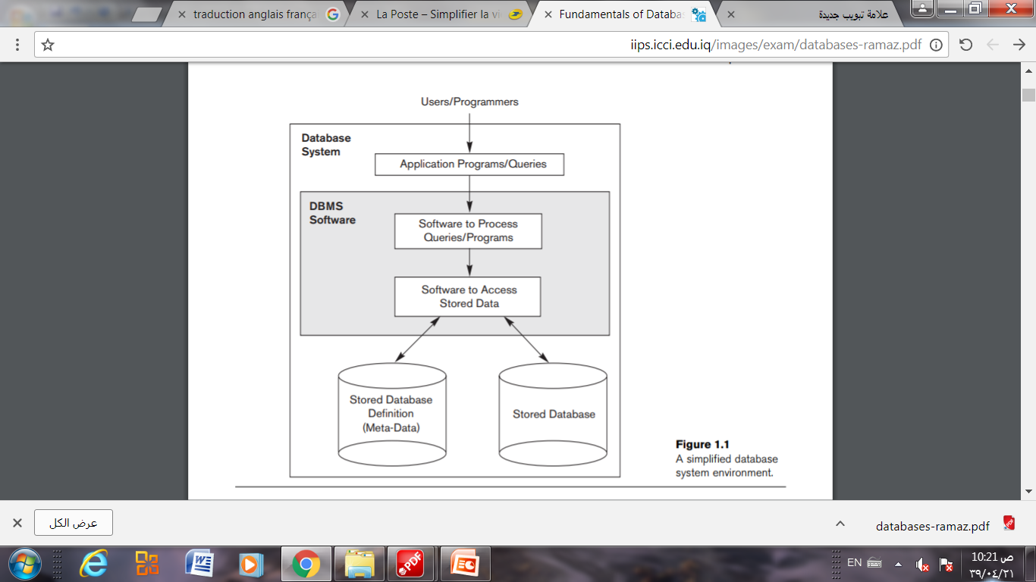
2- 1- Self-describing nature of a database system
The database system contains not only the database itself
but also a complete definition or description of the database
structure and constraints.
This definition is stored in the DBMS catalog.
The information stored in the catalog is called
meta-data, and it describes the structure of the primary database.
A simplified database system environment

Slide 10
2-2 - Insulation between programs and data, and data abstraction
In traditional file processing, the structure of data files is embedded in the application programs, so any changes to the structure of a file may require changing all programs that access that file.
By contrast, DBMS access programs do not require such changes in most cases. The structure of data files is stored in the DBMS catalog separately from the access programs.
We call this property program-data independence.

Slide 11
2-2 - Insulation between programs and data, and data abstraction
So, The implementation (or method) of the operation is specified separately and can be changed without affecting the interface.
User application programs can operate on the data by invoking these operations through their names and arguments, regardless of how the operations are implemented.
We call this property program-operation independence.

Slide 12
2-2 - Insulation between programs and data, and data abstraction
The characteristic that allows
program-data independence + program-operation independence
is called
Data Abstraction

Slide 13
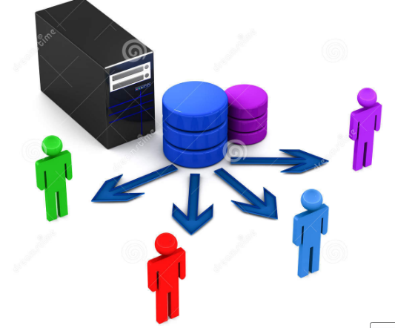
2- 3-Support of multiple views of the data
A database typically has many users, each of whom:
may require a different perspective or view of the database.
A view may be a subset of the database or it may contain virtual data that is derived from the database files but is not explicitly stored.

Slide 14
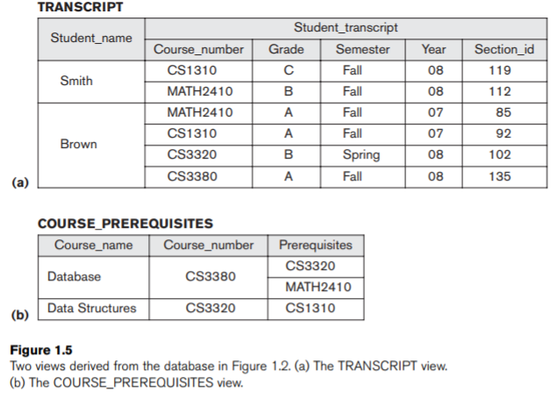
2- 3-Support of multiple views of the data
A multiuser DBMS whose users have a variety of distinct applications must provide facilities for defining multiple views.
For example
One user of the database may be interested only in accessing
and printing the transcript
of each student
A second user, who is interested only in checking that students have taken all the prerequisites of each course for which they register.

Slide 15
2-4- Sharing of Data and Multiuser Transaction Processing
The concept of a transaction has become central to many database applications.
A transaction is an executing program or process that includes one or more database accesses, such as reading or updating of database records.
Each transaction is supposed to execute a logically correct database access if executed in its entirety without interference from other transactions.

Slide 16
2-4- Sharing of Data and Multiuser Transaction Processing
For example
when several reservation agents try to assign a seat on an airline flight,
the DBMS should ensure that each seat can be accessed by only one agent at a time for assignment to a passenger.
These types of applications are generally called online transaction processing
(OLTP) applications.
A fundamental role of multiuser DBMS software is to ensure that concurrent transactions operate correctly and efficiently.

Slide 17
Outline
1- Introduction
2- Characteristics of the Database Approach
3-Actors on the Scene and Workers behind Scene
4-Advantages of Using the DBMS Approach
5- A Brief History of Database Applications
6- When Not to Use a DBMS

Slide 18
3- Actors on the scene and Workers behind Scene
In this section we identify the people whose jobs involve the day-to-day use of a large database; we call them the actors on the scene.
1- Database Administrators
2- Database Designers
Actors on the scene
3- End Users
4- System Analysts and Application Programmers (Software Engineers)

Slide 19
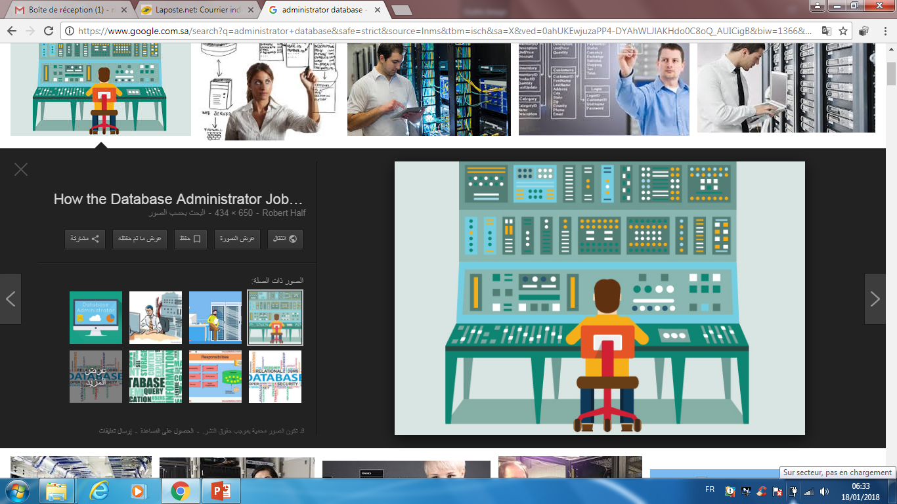
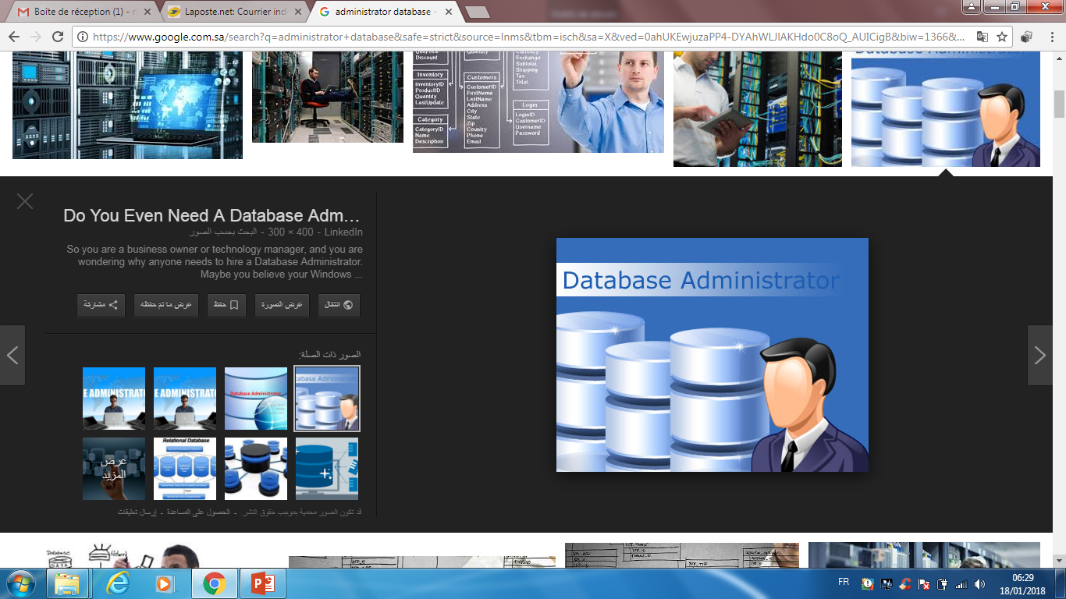
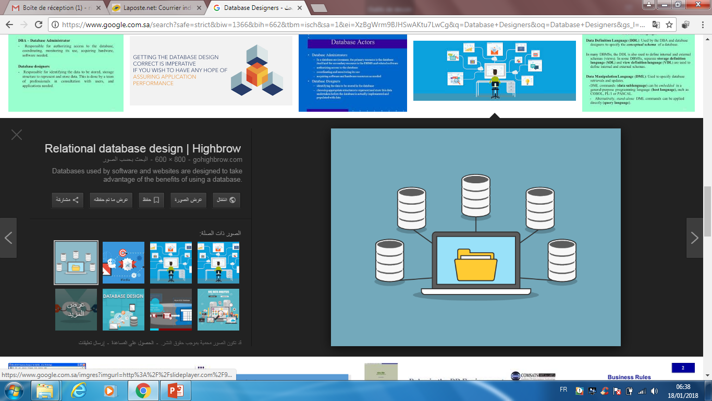
3-1- Database Administrators
In any organization where many people use the same resources, there is a need for a chief administrator to oversee and manage these resources.
Administering these resources is the responsibility of the database administrator (DBA).
The DBA is responsible for authorizing access to the database, coordinating and monitoring its use, and acquiring software and hardware resources as needed.

Slide 20
3-2- Database Designers
Database designers are responsible for identifying the data to be stored
in the database and for choosing appropriate structures to represent and
store this data.
These tasks are mostly undertaken before the database is
actually implemented and populated with data.

Slide 21
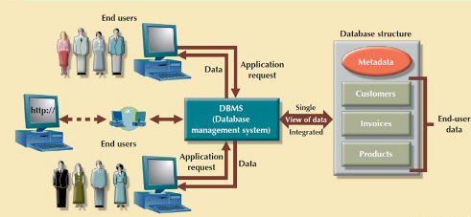
3-3- End Users
End users are the people whose jobs require access to the database for
querying, updating, and generating reports; the database primarily exists
for their use. There are several categories of end users:
1- Casual end users
2- Naive or parametric end users
End Users
3- Sophisticated end users
4- Standalone users

Slide 22
3-3- End Users
■ Casual end users
occasionally access the database, but they may need different information each time.
They use a sophisticated database query language to specify their requests and are typically middle- or high-level managers or other occasional browsers.
They do not write programs but they can interact with the system by writing queries.
■ Naive or parametric end users
Any user who does not have any knowledge about database can be in this category.
There task is to just use the developed application and get the desired results.
For example:
Clerical staff in any bank is a naïve user. They don’t have any DBMS knowledge but they still use the database and perform their given task.

Slide 23
3-3- End Users
Sophisticated end users
include engineers, scientists, business analysts, and others ..
who thoroughly familiarize themselves with the facilities of the DBMS
in order to implement their own applications to meet their complex requirements.
Standalone users
maintain personal databases by using ready-made program packages that provide easy-to-use menu-based or graphics-based interfaces.
An example is the user of a tax package that stores a variety of personal
financial data for tax purposes.

Slide 24
3- 4-System Analysts and Application Programmers (Software Engineers)
System analysts determine the requirements of end users, especially naive and parametric end users, and develop specifications for standard canned transactions that meet these requirements.

Slide 25
Outline
1- Introduction
2- Characteristics of the Database Approach
3-Actors on the Scene and Workers behind Scene
4-Advantages of Using the DBMS Approach
5- A Brief History of Database Applications
6- When Not to Use a DBMS

Slide 26
3- Workers behind Scene
In addition to those who design, use, and administer a database, others are associated with the design, development, and operation of the DBMS software and system environment.
These persons are typically not interested in the database content itself.
We call them the workers behind the scene, and they include the following categories:
3-1- DBMS system designers and implementers
3-2- Tool developers
3-3- Operators and maintenance personnel
They are responsible for the actual running and maintenance of
the hardware and software environment for the database system

Slide 27
Outline
1- Introduction
2- Characteristics of the Database Approach
3-Actors on the Scene and Workers behind Scene
4-Advantages of Using the DBMS Approach
5- A Brief History of Database Applications
6- When Not to Use a DBMS

Slide 28
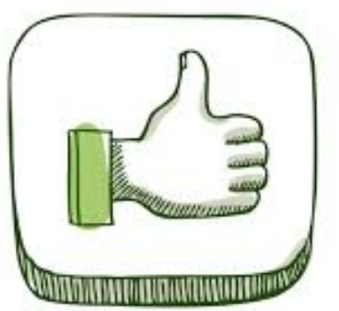
4- Advantages of Using the DBMS Approach
In this section we discuss some of the advantages of using a DBMS and the capabilities that a good DBMS should possess.
1 - Controlling Redundancy
2- Restricting Unauthorized Access
3- Providing Persistent Storage for Program Objects

Slide 29

4- Advantages of Using the DBMS Approach
4- Providing Storage Structures and Search Techniques for Efficient Query Processing
5- Providing Backup and Recovery
if the computer system fails in the middle of a complex update transaction, the recovery subsystem is responsible for making sure that the database is restored to the state it was in before the transaction started executing.
6-Providing Multiple User Interfaces
7- Representing Complex Relationships among Data

Slide 30

4- Advantages of Using the DBMS Approach
8 - Enforcing Integrity Constraints
9 -Permitting Inferencing and Actions Using Rules
10- Additional Implications of Using the Database Approach
A Potential for Enforcing Standards,
Reduced Application Development Time,
Flexibility,
Availability of Up-to-Date Information,
Economies of Scale.

Slide 31
Outline
1- Introduction
2- Characteristics of the Database Approach
3-Actors on the Scene and Workers behind Scene
4-Advantages of Using the DBMS Approach
5- A Brief History of Database Applications
6- When Not to Use a DBMS

Slide 32
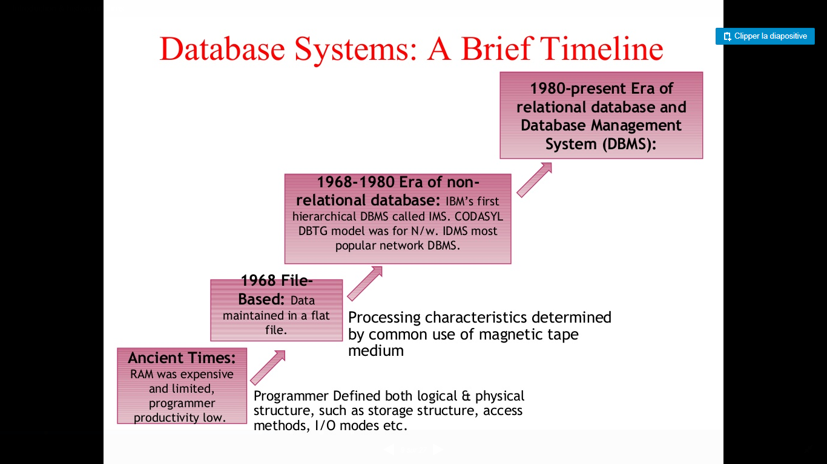
5- A Brief History of Database Applications

Slide 33
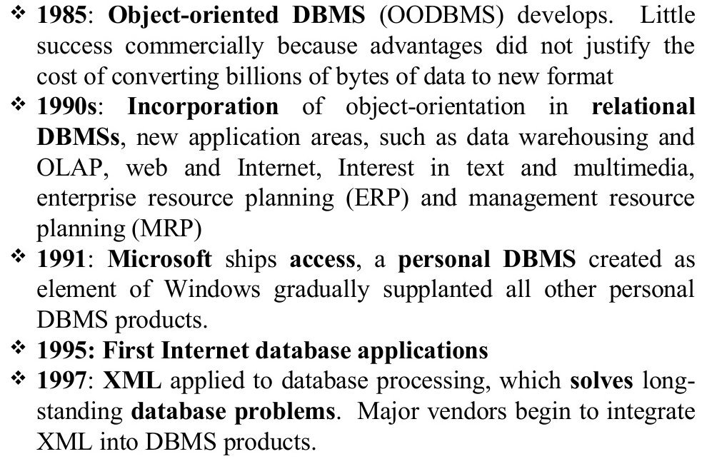
5- A Brief History of Database Applications

Slide 34
Outline
1- Introduction
2- Characteristics of the Database Approach
3-Actors on the Scene and Workers behind Scene
4-Advantages of Using the DBMS Approach
5- A Brief History of Database Applications
6- When Not to Use a DBMS

Slide 35
6- When Not to Use a DBMS
In spite of the advantages of using a DBMS, there are a few situations in which a DBMS may involve unnecessary overhead costs that would not be incurred in traditional file processing.
■ Simple, well-defined database applications that are not expected to change at all,
■ Stringent, real-time requirements for some application programs that may not be met because of DBMS overhead,
■ Embedded systems with limited storage capacity, where a general-purpose DBMS would not fit,
■No multiple-user access to data.

Slide 36

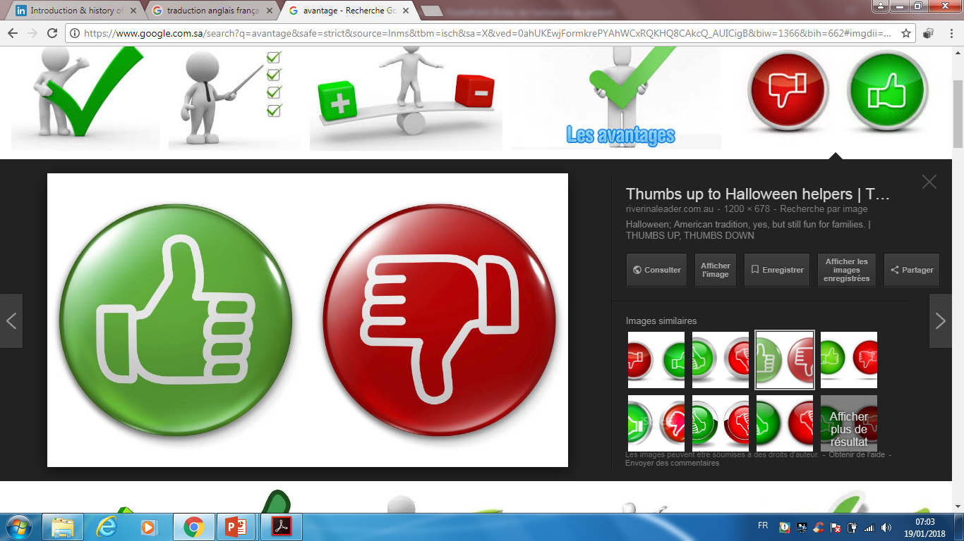
Summary
To implement and manage database, use DBMS.
Database design defines the database structure.
A poorly designed database can lead to bad decision making, and bad decision making lead to the failure of an organization.
A well-designed database facilities data managment
and generates accurate and valubale information.

Slide 37

Thank you for your attention

Slide 38

Do you have any questions ???
???

